Slide 1

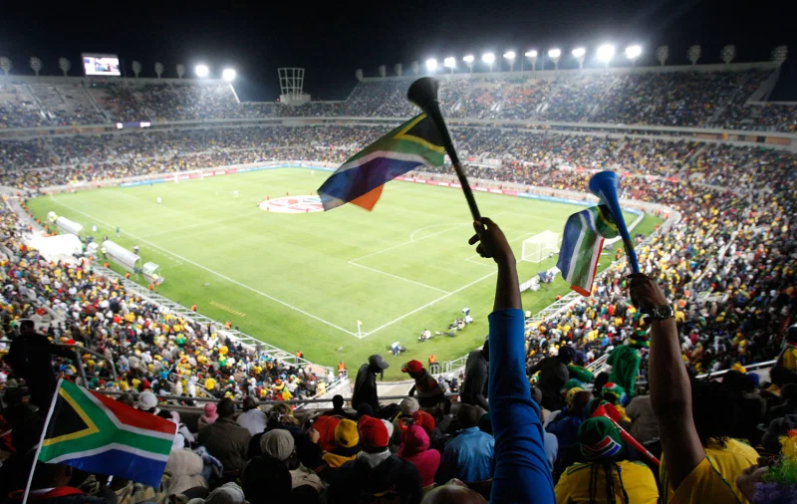
World cup matches
EXPLORATORY DATA ANALYSIS and classification ON WORLD CUP MATCHES
BY ROHIT SUBRAMANIAM

Slide 2
agenda
1. BUSINESS/DATA QUESTIONS
2. PROJECT PIPELINE
3. RESULTS
4. SUMMARY
5. CONCLUSIONS AND FURTHER WORK

Slide 3
BUSINESS QUESTION
Effect of home ground on home team performance?
DATA QUESTION
1. What are the characteristics of the dataset?
2. Which model accurately reflects home ground on home team performance?

Slide 4
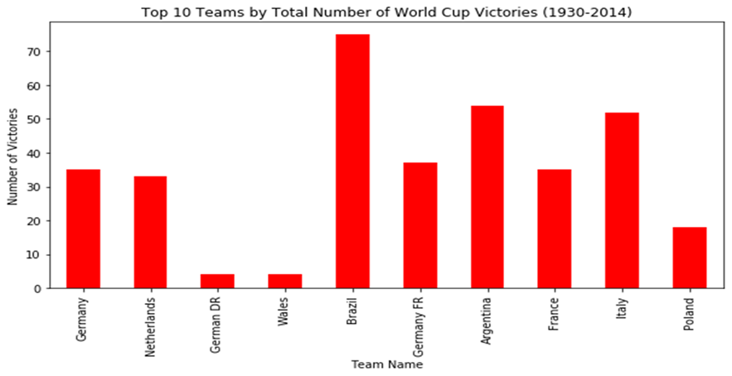
Performance trends
Figure 1: Top 10 performing teams in the World cup from 1930-2014

Slide 5
PROJECT PIPELINE
Background context
Stakeholders
Business and data questions
Business and Data Answers
Imported world cup dataset
Data Analysis
Key Variable Selections
CLASSIFICATION AND ENCODING
CONCLUSIONS

Slide 6
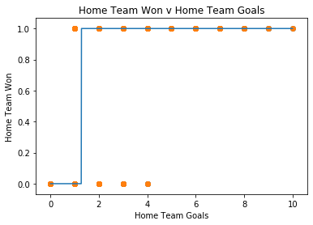
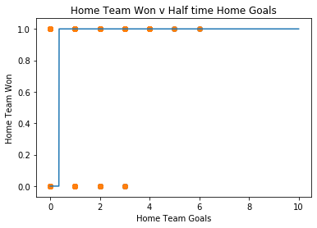
LOGISTIC REGRESSION results
Home Team Won = 1.99 x Home Team Goals -2.55
Home Team Won = 1.49 x Home Team Goals -0.53
Half time Home Goals
Figure 2: Relationship between Home Team Won and Home Team Goals
Figure 3: Relationship between Home Team Won and Half time Team Goals

Slide 7
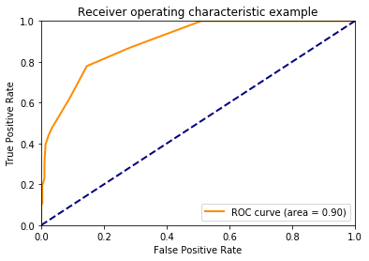
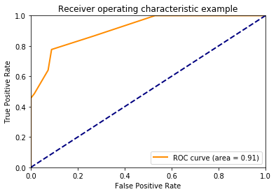
Performance of LOGISITC REGRESSION
Figure 4: Receiver Operating Characteristics for training data set
Figure 5: Receiver Operating Characteristics for test data set

Slide 8
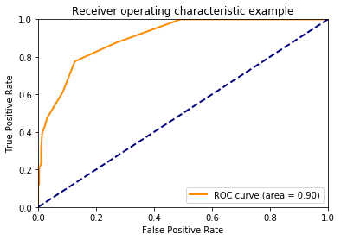
Performance of LOGISITC REGRESSION (cont*)
Figure 6: Receiver Operating Characteristics for test data set with additional variables included
Figure 7: Receiver Operating Characteristics for training data set with additional variables included

Slide 9
Score and ACCURACY OF LOGISTIC REGRESSION
Variables included | Score | Accuracy
Attendance, Home Team Goals and Half time Home Goals | 0.73 | 0.8120 (training data set) 0.8304 (test data set)
Home Team Goals, Half-time Difference, Half-time Home Goals, Score Difference, and Attendance | 1.0 | 0.8120 (training data set) 0.8304 (test data set)
Table 1: Performance of logistic regression

Slide 10
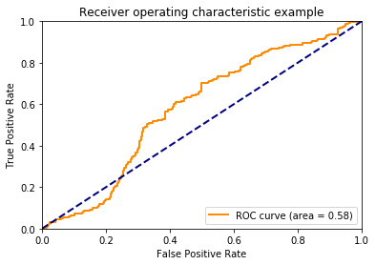
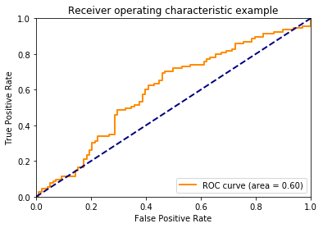
Performance of SUPPORT VECTOR MACHINE
Figure 8: Receiver Operating Characteristics for training data set
Figure 9: Receiver Operating Characteristics for test data set

Slide 11
SUPPORT VECTOR MACHINE RESULTS
 | Precision | Recall | F1 – score | Support
Class 1 | 0.57 | 0.38 | 0.45 | 98
Class 2 | 0.59 | 0.76 | 0.66 | 115
Accuracy |  |  | 0.58 | 213
Macro Average | 0.58 | 0.57 | 0.56 | 213
Weighted Average | 0.58 | 0.58 | 0.57 | 213
Table 2: Performance of support vector machine

Slide 12
SUMMARY
DATA
METHOD
OUTCOMES
* Data consists of both categorical and numerical variables.
* Imported world cup dataset
* Created variables, winner and home team won.
* Imputed variable, ‘attendance.’
* Used appropriate modelling and encoding to identify effect of home ground on home team performance.
* Logistic regression accurately reflects home ground effect on home team’s performance.
* Data consists of 853 entries from 1930 to 2014.
* Only the variable ‘attendance’ has 2 null values.

Slide 13
CONCLUSIONS
Home Ground has strong effect on home team performance as shown in logistic regression.
Support Vector Machine shows that home ground has moderate impact on home team performance.
FURTHER WORK
Apply other classification models such as neural networks to see if same conclusion can be drawn.
Determine what other variables effect home team performance such as attendance.
Impact of home ground on away team performance.

